Slide 1
Java DataBase Connectivity

Slide 2
Structured Query Language (SQL)
Language to query the database
Types of SQL
Data Definition Language (DDL)
Creating tables and other database objects, etc.
Data Manipulation Language (DML)
Inserting, Updating, Deleting the records
Data Control Language (DCL)
Granting privileges, revoking them

Slide 3
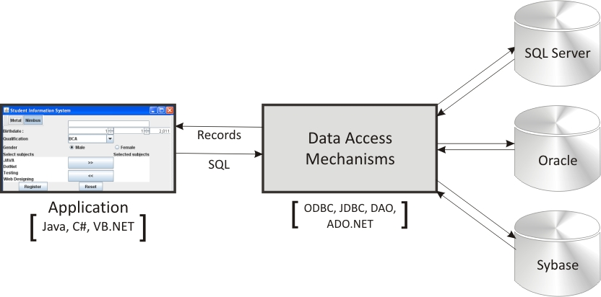
Data Access Mechanisms

Slide 4
JDBC
JDBC stands for Java Database Connectivity, which is a standard Java API for database-independent connectivity between the Java programming language and a wide range of databases.
The JDBC library includes APIs for each of the tasks mentioned below that are commonly associated with database usage.
Making a connection to a database.
Creating SQL or MySQL statements.
Executing SQL or MySQL queries in the database.
Viewing & Modifying the resulting records.

Slide 5
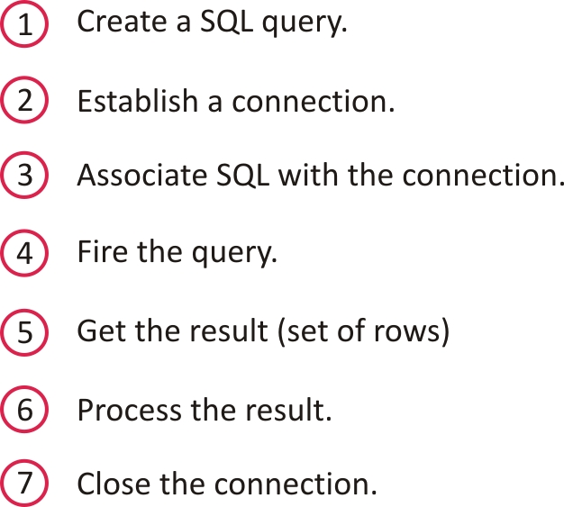
Accessing the Data: Steps

Slide 6
Common JDBC Components
The JDBC API provides the following interfaces and classes −
DriverManager − This class manages a list of database drivers. Matches connection requests from the java application with the proper database driver using communication sub protocol. The first driver that recognizes a certain subprotocol under JDBC will be used to establish a database Connection.
Driver − This interface handles the communications with the database server. You will interact directly with Driver objects very rarely. Instead, you use DriverManager objects, which manages objects of this type. It also abstracts the details associated with working with Driver objects.
Connection − This interface with all methods for contacting a database. The connection object represents communication context, i.e., all communication with database is through connection object only.
Statement − You use objects created from this interface to submit the SQL statements to the database. Some derived interfaces accept parameters in addition to executing stored procedures.
ResultSet − These objects hold data retrieved from a database after you execute an SQL query using Statement objects. It acts as an iterator to allow you to move through its data.
SQLException − This class handles any errors that occur in a database application.

Slide 7
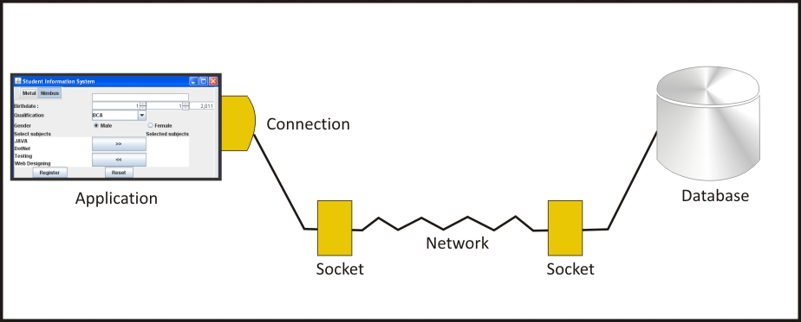
Connection and JDBC Drivers

Slide 8

Types of JDBC Drivers
Driver is a program which allows the application to
establish connection with the database by hiding
complexity of handling network connection/sockets.
JDBC-ODBC Bridge (Type 1)
Native-API partly Java Driver (Type 2)
Net-Protocol All-Java Driver (Type 3)
Native Protocol All-Java Driver (Type 4)
List of JDBC Drivers
http://industry.java.sun.com/products/jdbc/drivers

Slide 9
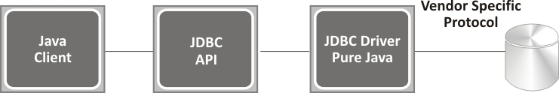
Native Protocol All-Java Driver (Type 4)
JDBC calls are directly converted to network protocol used by the DBMS server.
driver usually comes only from DB-vendor.

Slide 10
JDBC URL: Locate the database
Needed by drivers to locate, access and get other valid information about the databases.
Typical Syntax
jdbc:[subprotocol]:[subname][attributes]
JDBC URL examples
jdbc:oracle:thin:@localhost:port:service
e.g
1) jdbc:oracle:thin:@localhost:1521:global
2) jdbc:mysql://localhost:3306/test

Slide 11
Java Database Connectivity with Oracle
To connect java application with the oracle database, we need to follow 5 following steps. we need to know following information for the oracle database:
Driver class: The driver class for the oracle database is oracle.jdbc.driver.OracleDriver.
Connection URL: The connection URL for the oracle database is jdbc:oracle:thin:@localhost:1521:xe
where jdbc is the API, oracle is the database, thin is the driver, localhost is the server name on which oracle is running, we may also use IP address, 1521 is the port number and XE is the Oracle service name. You may get all these information from the tnsnames.ora file.
Username: The default username for the oracle database is system.
Password: It is the password given by the user at the time of installing the oracle database.

Slide 12
Executing a Simple SQL Query
String url = “jdbc:odbc:MyDataSource”
Connection con = DriverManager.getConnection(url);
Statement stmt = con.createStatement();
String sql = “SELECT Last_Name FROM EMPLOYEES”;
ResultSet rs = stmt.executeQuery(sql);
while(rs.next())
{ System.out.println(rs.getString(“Last_Name”));
}

Slide 13
What is JDBC Driver?
JDBC drivers implement the defined interfaces in the JDBC API, for interacting with your database server.
What Is Connection Interface?
A Connection is the session between java application and database. The Connection interface is a factory of Statement, PreparedStatement, and DatabaseMetaData i.e. object of Connection can be used to get the object of Statement and DatabaseMetaData.

Slide 14
Statement interface
The Statement interface provides methods to execute queries with the database. The statement interface is a factory of ResultSet i.e. it provides factory method to get the object of ResultSet.
Commonly used methods of Statement interface:
The important methods of Statement interface are as follows:
1) public ResultSet executeQuery(String sql): is used to execute SELECT query. It returns the object of ResultSet.
2) public int executeUpdate(String sql): is used to execute specified query, it may be create, drop, insert, update, delete etc.

